Slide 1
Inception-Resnet-Densenet
Dr Milan Joshi

Slide 2
Inception Module

Slide 3
AlexNet → VGG-16

Slide 4
AlexNet → VGG-16
Model | # layers
AlexNet | 8
VGG-16 | 16

Slide 5
AlexNet → VGG-16
Model | # layers | Maximum # filters
AlexNet | 8 | 384
VGG-16 | 16 | 512

Slide 6
Reasons for Improved Performance

Slide 7
Reasons for Improved Performance
Depth of the network

Slide 8
Reasons for Improved Performance
Depth of the network
Width of the network

Slide 9
Disadvantages of Deeper Networks

Slide 10
Disadvantages of Deeper Networks
Higher chance of Overfitting

Slide 11
Disadvantages of Deeper Networks
Higher chance of Overfitting
Increasing number of parameters

Slide 12
Dimensionality Reduction Module (1X1 convolution)

Slide 13
Dimensionality Reduction Module (1X1 convolution)
Input
14 X 14 X 512

Slide 14
Dimensionality Reduction Module (1X1 convolution)
Input
14 X 14 X 512
Filter
3 X 3 X 64

Slide 15
Dimensionality Reduction Module (1X1 convolution)
Input
14 X 14 X 512
Filter
3 X 3 X 64
Output
14 X 14 X 64

Slide 16
Dimensionality Reduction Module (1X1 convolution)
Input
14 X 14 X 512
Filter
3 X 3 X 64
Output
14 X 14 X 64
# operations = 14*14*512*3*3*64 = 57.8 Million

Slide 17
Dimensionality Reduction Module (1X1 convolution)
Input
14 X 14 X 512
Filter
3 X 3 X 64
Output
14 X 14 X 64
# operations = 14*14*512*3*3*64 = 57.8 Million
Input
14 X 14 X 512

Slide 18
Dimensionality Reduction Module (1X1 convolution)
Input
14 X 14 X 512
Filter
3 X 3 X 64
Output
14 X 14 X 64
# operations = 14*14*512*3*3*64 = 57.8 Million
Input
14 X 14 X 512
Filter
1 X 1 X 32

Slide 19
Dimensionality Reduction Module (1X1 convolution)
Input
14 X 14 X 512
Filter
3 X 3 X 64
Output
14 X 14 X 64
# operations = 14*14*512*3*3*64 = 57.8 Million
Input
14 X 14 X 512
Filter
1 X 1 X 32
Output
14 X 14 X 32

Slide 20
Dimensionality Reduction Module (1X1 convolution)
Input
14 X 14 X 512
Filter
3 X 3 X 64
Output
14 X 14 X 64
# operations = 14*14*512*3*3*64 = 57.8 Million
Input
14 X 14 X 512
Filter
1 X 1 X 32
Output
14 X 14 X 32
Filter
3 X 3 X 64

Slide 21
Dimensionality Reduction Module (1X1 convolution)
Input
14 X 14 X 512
Filter
3 X 3 X 64
Output
14 X 14 X 64
# operations = 14*14*512*3*3*64 = 57.8 Million
Input
14 X 14 X 512
Filter
1 X 1 X 32
Output
14 X 14 X 32
Filter
3 X 3 X 64
Output
14 X 14 X 64

Slide 22
Dimensionality Reduction Module (1X1 convolution)
Input
14 X 14 X 512
Filter
3 X 3 X 64
Output
14 X 14 X 64
# operations = 14*14*512*3*3*64 = 57.8 Million
Input
14 X 14 X 512
Filter
1 X 1 X 32
Output
14 X 14 X 32
Filter
3 X 3 X 64
Output
14 X 14 X 64
# operations = 14*14*512*1*1*32 = 3.2 Million

Slide 23
Dimensionality Reduction Module (1X1 convolution)
Input
14 X 14 X 512
Filter
3 X 3 X 64
Output
14 X 14 X 64
# operations = 14*14*512*3*3*64 = 57.8 Million
Input
14 X 14 X 512
Filter
1 X 1 X 32
Output
14 X 14 X 32
Filter
3 X 3 X 64
Output
14 X 14 X 64
# operations = 14*14*512*1*1*32 = 3.2 Million
# operations = 14*14*32*3*3*64 = 3.6 Million

Slide 24
Dimensionality Reduction Module (1X1 convolution)
Input
14 X 14 X 512
Filter
3 X 3 X 64
Output
14 X 14 X 64
# operations = 14*14*512*3*3*64 = 57.8 Million
Input
14 X 14 X 512
Filter
1 X 1 X 32
Output
14 X 14 X 32
Filter
3 X 3 X 64
Output
14 X 14 X 64
# operations = 14*14*512*1*1*32 = 3.2 Million
# operations = 14*14*32*3*3*64 = 3.6 Million
Total # operations = 3.2 + 3.6 = 6.8 Million

Slide 25
Inception Module

Slide 26


Inception Module

Slide 27
Inception Module

Slide 28
Inception Module
Previous Layer

Slide 29
Inception Module
Previous Layer
1 X 1 Conv
3 X 3 Conv
5 X 5 Conv
3 X 3 Max Pool

Slide 30
Inception Module
Previous Layer
1 X 1 Conv
3 X 3 Conv
5 X 5 Conv
3 X 3 Max Pool
Filter Concatenation

Slide 31
Inception Module with Dimensionality Reduction
Previous Layer

Slide 32
Inception Module with Dimensionality Reduction
Previous Layer
1 X 1 Conv
3 X 3 Max Pool
1 X 1 Conv
1 X 1 Conv
3 X 3 Conv
5 X 5 Conv
1 X 1 Conv

Slide 33
Inception Module with Dimensionality Reduction
Previous Layer
1 X 1 Conv
3 X 3 Max Pool
1 X 1 Conv
1 X 1 Conv
5 X 5 Conv
1 X 1 Conv
3 X 3 Conv
Filter Concatenation

Slide 34
Advantages of Inception Module

Slide 35
Advantages of Inception Module
No need to worry about deciding the filter size

Slide 36
Advantages of Inception Module
No need to worry about deciding the filter size
Reduces the number of operations using dimensionality reduction module

Slide 37
Advantages of Inception Module
No need to worry about deciding the filter size
Reduces the number of operations using dimensionality reduction module
Can build deeper networks

Slide 38
Inception V1 / GoogLeNet

Slide 39
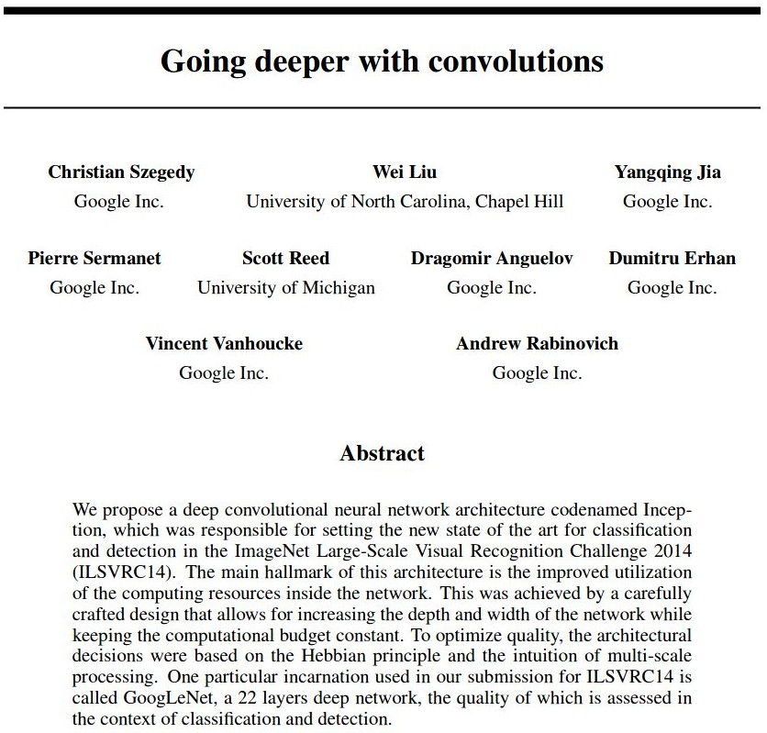
Inception V1 / GoogLeNet
Proposed in 2014

Slide 40
Inception V1 / GoogLeNet
Proposed in 2014
It has 22 layers with learnable parameters

Slide 41
Inception V1 / GoogLeNet
Proposed in 2014
It has 22 layers with learnable parameters
Architecture details:
2 initial convolution layers with max pooling

Slide 42
Inception V1 / GoogLeNet
Proposed in 2014
It has 22 layers with learnable parameters
Architecture details:
2 initial convolution layers with max pooling
9 inception modules

Slide 43
Inception V1 / GoogLeNet
Proposed in 2014
It has 22 layers with learnable parameters
Architecture details:
2 initial convolution layers with max pooling
9 inception modules
2 fully connected layers

Slide 44
Inception V1 / GoogLeNet
Proposed in 2014
It has 22 layers with learnable parameters
Architecture details:
2 initial convolution layers with max pooling
9 inception modules
2 fully connected layers
Trained on imagenet dataset

Slide 45
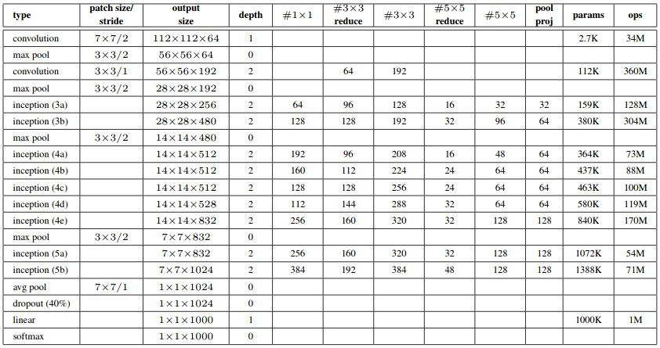
Architecture: GoogLeNet

Slide 46
Architecture: GoogLeNet

Slide 47
Architecture: GoogLeNet

Slide 48
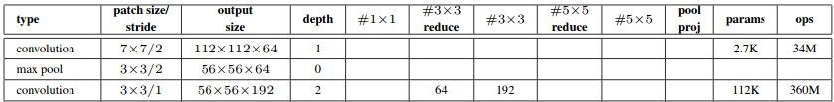
Architecture: GoogLeNet

Slide 49
Architecture: GoogLeNet
Input
56 X 56 X 64

Slide 50
Architecture: GoogLeNet
Input
56 X 56 X 64
Filter
1 X 1 X 64

Slide 51
Architecture: GoogLeNet
Input
56 X 56 X 64
Filter
1 X 1 X 64
Output
56 X 56 X 64

Slide 52
Architecture: GoogLeNet
Input
56 X 56 X 64
Filter
1 X 1 X 64
Output
56 X 56 X 64
Filter
3 X 3 X 192

Slide 53
Architecture: GoogLeNet
Input
56 X 56 X 64
Filter
1 X 1 X 64
Output
56 X 56 X 64
Filter
3 X 3 X 192
Output
56 X 56 X 192

Slide 54
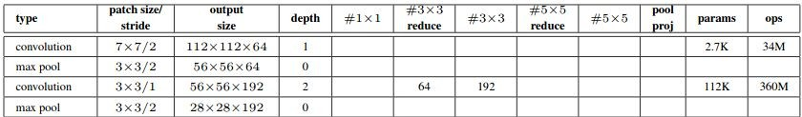
Architecture: GoogLeNet

Slide 55
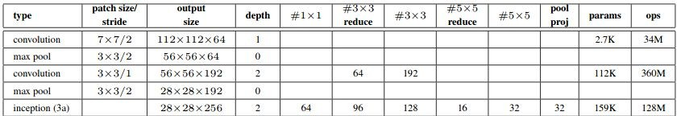
Architecture: GoogLeNet

Slide 56
Architecture: GoogLeNet
28 X 28 X 192

Slide 57
Architecture: GoogLeNet
28 X 28 X 192
1 X 1 (64)

Slide 58
Architecture: GoogLeNet
28 X 28 X 192
1 X 1 (96)
1 X 1 (64)

Slide 59
Architecture: GoogLeNet
28 X 28 X 192
1 X 1 (96)
1 X 1 (64)
3 X 3 (128)

Slide 60
Architecture: GoogLeNet
28 X 28 X 192
1 X 1 (96)
1 X 1 (16)
1 X 1 (64)
3 X 3 (128)

Slide 61
Architecture: GoogLeNet
28 X 28 X 192
1 X 1 (96)
1 X 1 (16)
1 X 1 (64)
3 X 3 (128)
5 X 5 (32)

Slide 62
Architecture: GoogLeNet
28 X 28 X 192
1 X 1 (96)
1 X 1 (16)
3 X 3 max pool
1 X 1 (64)
3 X 3 (128)
5 X 5 (32)

Slide 63
Architecture: GoogLeNet
28 X 28 X 192
1 X 1 (96)
1 X 1 (16)
3 X 3 max pool
1 X 1 (64)
3 X 3 (128)
5 X 5 (32)
1 X 1 (32)

Slide 64
Architecture: GoogLeNet
28 X 28 X 192
1 X 1 (96)
1 X 1 (16)
3 X 3 max pool
1 X 1 (64)
3 X 3 (128)
5 X 5 (32)
1 X 1 (32)
28 X 28 X 256

Slide 65
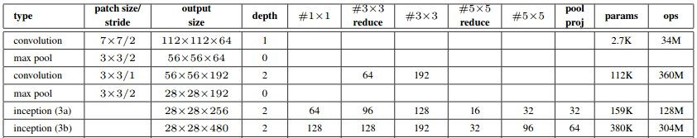
Architecture: GoogLeNet

Slide 66
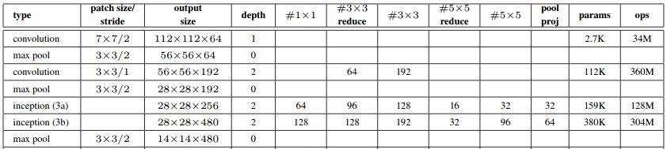
Architecture: GoogLeNet

Slide 67
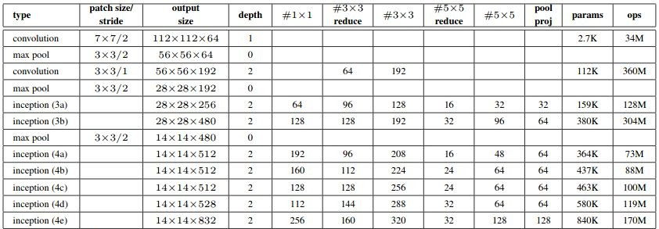
Architecture: GoogLeNet

Slide 68
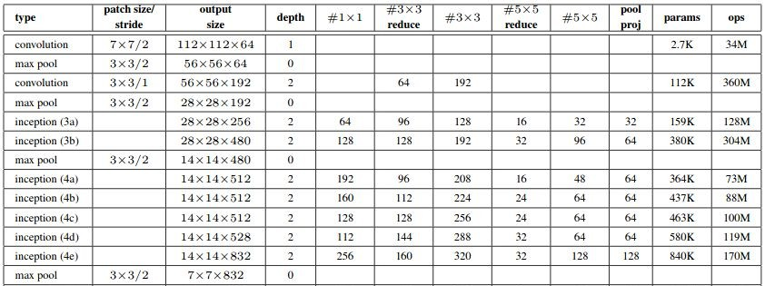
Architecture: GoogLeNet

Slide 69
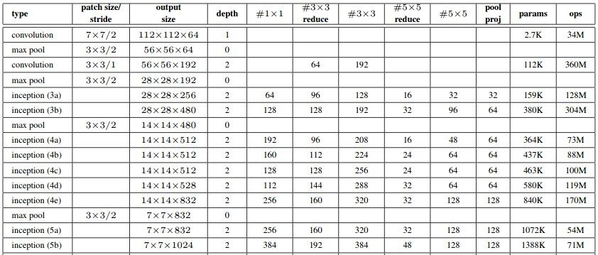
Architecture: GoogLeNet

Slide 70
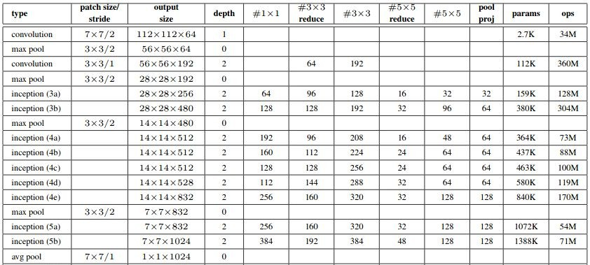
Architecture: GoogLeNet

Slide 71
Architecture: GoogLeNet

Slide 72
Architecture: GoogLeNet
Number of Parameters = 6.8 million

Slide 73
Auxiliary Classifiers

Slide 74
Auxiliary Classifiers
Average pooling: filter size - 5 X 5, stride - 3

Slide 75
Auxiliary Classifiers
Average pooling: filter size - 5 X 5, stride - 3
1 X 1 convolution with 128 filters: dimensionality reduction + ReLU

Slide 76
Auxiliary Classifiers
Average pooling: filter size - 5 X 5, stride - 3
1 X 1 convolution with 128 filters: dimensionality reduction + ReLU
Fully connected layer with 1024 neurons + ReLU

Slide 77
Auxiliary Classifiers
Average pooling: filter size - 5 X 5, stride - 3
1 X 1 convolution with 128 filters: dimensionality reduction + ReLU
Fully connected layer with 1024 neurons + ReLU
Dropout layer: dropout ratio - 70%

Slide 78
Auxiliary Classifiers
Average pooling: filter size - 5 X 5, stride - 3
1 X 1 convolution with 128 filters: dimensionality reduction + ReLU
Fully connected layer with 1024 neurons + ReLU
Dropout layer: dropout ratio - 70%
Fully connected layer with 1000 neurons + Softmax

Slide 79
Auxiliary Classifiers
Average pooling: filter size - 5 X 5, stride - 3
1 X 1 convolution with 128 filters: dimensionality reduction + ReLU
Fully connected layer with 1024 neurons + ReLU
Dropout layer: dropout ratio - 70%
Fully connected layer with 1000 neurons + Softmax
No auxiliary classifier at inference time

Slide 80
Auxiliary Classifiers
Total loss = Real_loss + 0.3 * aux_loss_1 + 0.3 * aux_loss_2

Slide 81
Summary: GoogLeNet

Slide 82
Summary: GoogLeNet
It has 22 layers with learnable parameters

Slide 83
Summary: GoogLeNet
It has 22 layers with learnable parameters
Takes RGB image as input

Slide 84
Summary: GoogLeNet
It has 22 layers with learnable parameters
Takes RGB image as input
Architecture details:
2 initial convolution layers with max pooling
9 inception modules
2 fully connected layers
2 Auxiliary classifiers

Slide 85
Summary: GoogLeNet
It has 22 layers with learnable parameters
Takes RGB image as input
Architecture details:
2 initial convolution layers with max pooling
9 inception modules
2 fully connected layers
2 Auxiliary classifiers
Total number of parameters: 6.8 million

Slide 86
Different versions of Inception

Slide 87
Challenges with GoogLeNet

Slide 88
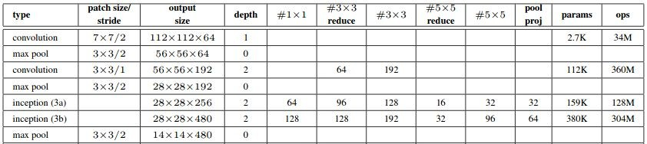
Challenges with GoogLeNet
High computational cost (e.g. using 5X5 or 7X7 filters)

Slide 89
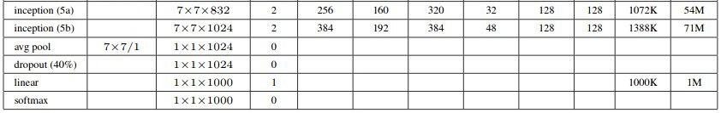
Challenges with GoogLeNet
High computational cost (e.g. using 5X5 or 7X7 filters)
Reduce representational bottleneck

Slide 90
GoogLeNet: High Computational Cost

Slide 91
High Computational Cost Solution: Factorized Convolution

Slide 92
High Computational Cost Solution: Factorized Convolution
Previous Layer
1 X 1 Conv
1 X 1 Conv
3 X 3 Max Pool
1 X 1 Conv
3 X 3 Conv
5 X 5 Conv
1 X 1 Conv
Filter
Concatenation

Slide 93
High Computational Cost Solution: Factorized Convolution
Previous Layer
1 X 1 Conv
1 X 1 Conv
3 X 3 Max Pool
1 X 1 Conv
3 X 3 Conv
5 X 5 Conv
1 X 1 Conv
Filter
Concatenation

Slide 94
High Computational Cost Solution: Factorized Convolution
Previous Layer
1 X 1 Conv
1 X 1 Conv
3 X 3 Max Pool
1 X 1 Conv
3 X 3 Conv
3 X 3 Conv
1 X 1 Conv
3 X 3 Conv
Filter
Concatenation

Slide 95
High Computational Cost Solution: Factorized Convolution
5X5 Conv

Slide 96
High Computational Cost Solution: Factorized Convolution
5X5 Conv

Slide 97
High Computational Cost Solution: Factorized Convolution
5X5 Conv

Slide 98
High Computational Cost Solution: Factorized Convolution
5X5 Conv
Two 3X3 Conv

Slide 99
Module 1
Previous Layer
1 X 1 Conv
1 X 1 Conv
3 X 3 Max Pool
1 X 1 Conv
3 X 3 Conv
3 X 3 Conv
1 X 1 Conv
3 X 3 Conv
Filter
Concatenation

Slide 100
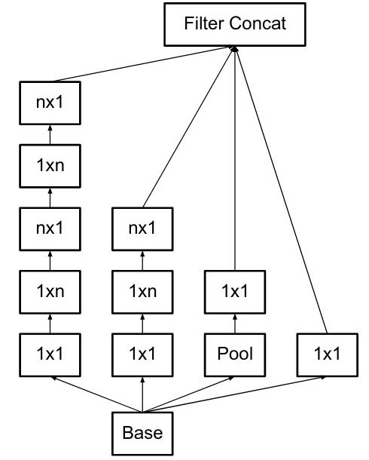
High Computational Cost Solution: Factorized Convolution

Slide 101
High Computational Cost Solution: Factorized Convolution

Slide 102
High Computational Cost Solution: Factorized Convolution

Slide 103
High Computational Cost Solution: Factorized Convolution

Slide 104
Module 2

Slide 105
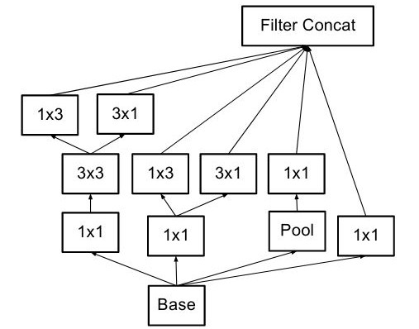
Wider filters

Slide 106
Module 1
Previous Layer
1 X 1 Conv
1 X 1 Conv
3 X 3 Max Pool
1 X 1 Conv
3 X 3 Conv
3 X 3 Conv
1 X 1 Conv
3 X 3 Conv
Filter
Concatenation

Slide 107
Module 2

Slide 108
Module 3

Slide 109
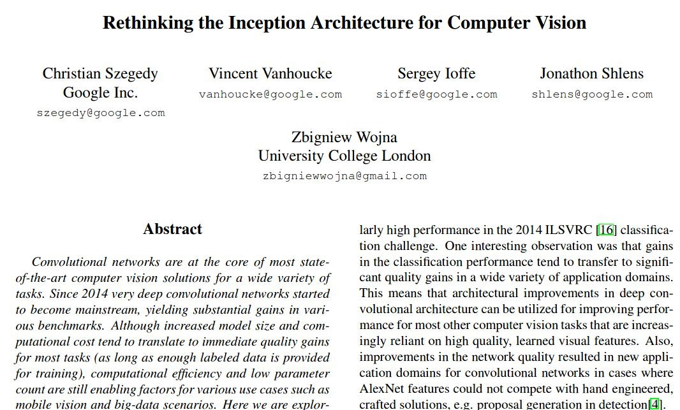
Inception V2
Proposed in 2015

Slide 110
Inception V2
Proposed in 2015
It has 42 layers

Slide 111
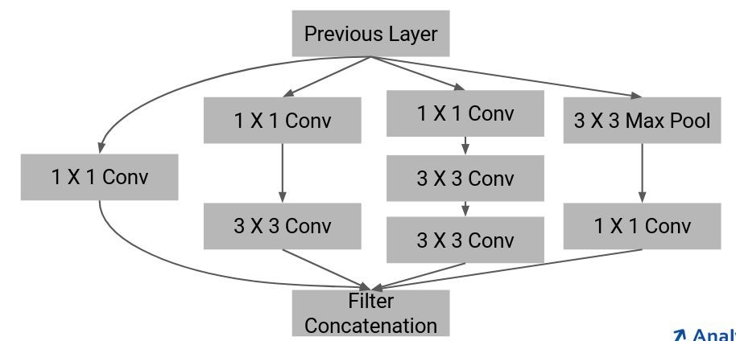
Inception V2
Proposed in 2015
It has 42 layers
Architectural details:
3 Inception module 1

Slide 112
Inception V2
Proposed in 2015
It has 42 layers
Architectural details:
3 Inception module 1
5 Inception module 2

Slide 113
Inception V2
Proposed in 2015
It has 42 layers
Architectural details:
3 Inception module 1
5 Inception module 2
2 Inception module 3

Slide 114
Inception V2
Proposed in 2015
It has 42 layers
Architectural details:
3 Inception module 1
5 Inception module 2
2 Inception module 3
Global average pooling

Slide 115
Inception V2
Proposed in 2015
It has 42 layers
Architectural details:
3 Inception module 1
5 Inception module 2
2 Inception module 3
Global average pooling
2 Fully connected layers

Slide 116
Inception V2
Proposed in 2015
It has 42 layers
Architectural details:
3 Inception module 1
5 Inception module 2
2 Inception module 3
Global average pooling
2 Fully connected layers
Trained on ImageNet dataset

Slide 117
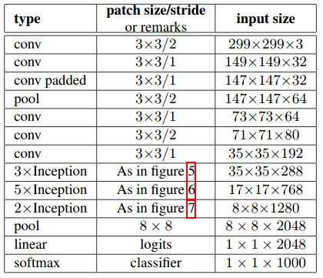
Architecture: Inception V2

Slide 118
Inception V3

Slide 119
Inception V3
RMSProp optimizer

Slide 120
Inception V3
RMSProp optimizer
Only 1 auxiliary classifier is used

Slide 121
Inception V3
RMSProp optimizer
Only 1 auxiliary classifier is used
Added Batch Normalization in the auxiliary classifier

Slide 122
Comparing versions of Inception
Model
Top-5 Error

Slide 123
Comparing versions of Inception
Model | Top-5 Error
GoogLeNet / Inception V1 | 7.89%

Slide 124
Comparing versions of Inception
Model | Top-5 Error
GoogLeNet / Inception V1 | 7.89%
Inception V2 | 5.82%

Slide 125
Comparing versions of Inception
Model | Top-5 Error
GoogLeNet / Inception V1 | 7.89%
Inception V2 | 5.82%
Inception V3 | 4.2%

Slide 126
Residual Blocks

Slide 127
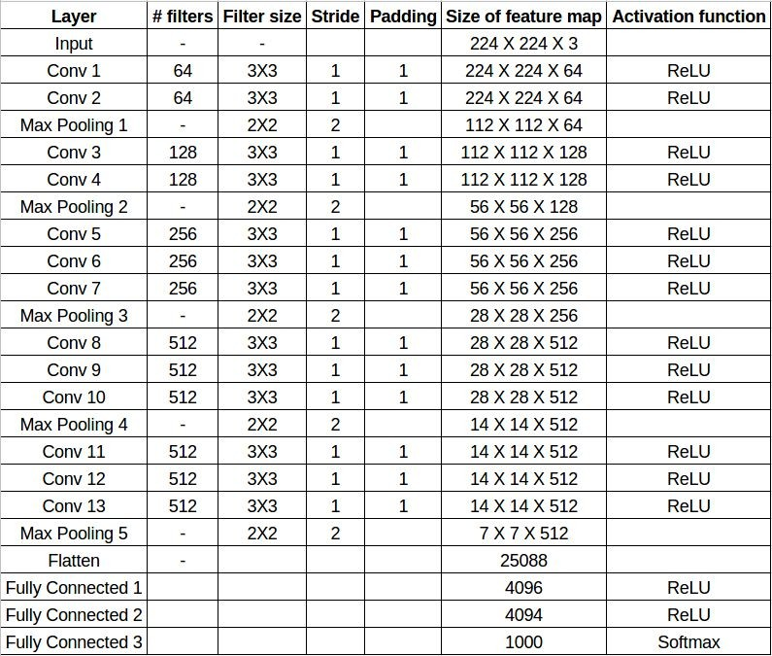
VGG-16
Number of layers = 16

Slide 128
GoogLeNet
Number of layers = 22

Slide 129
Inception V3
Number of layers = 42

Slide 130
Problem with Deep Networks

Slide 131
Problem with Deep Networks
1. Vanishing / Exploding gradients

Slide 132
Problem with Deep Networks
Vanishing / Exploding gradients
Solution:
Normalized Weight initialization
Adding Batch Normalization

Slide 133
Problem with Deep Networks
2. With increasing depth, performance starts degrading rapidly

Slide 134
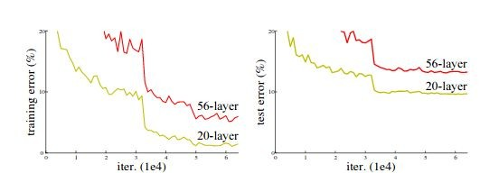
Problem with Deep Networks
2. With increasing depth, performance starts degrading rapidly

Slide 135
Problem with Deep Networks
Input
Layer 1
Layer 2
Layer 3
Layer 4
Layer 5
Output

Slide 136
Problem with Deep Networks
Input
Input
Layer 1
Layer 1
Layer 2
Layer 2
Layer 3
Layer 3
Layer 4
Layer 4
Layer 5
Layer 5
Output
Layer 6
Layer 7
Output

Slide 137
Problem with Deep Networks
Input
Input
Layer 1
Layer 1
Layer 2
Layer 2
Layer 3
Layer 3
Layer 4
Layer 4
Layer 5
Layer 5
Output
Layer 6
Layer 7
Output

Slide 138
Residual Learning
Previous layer Output (x)
Weighted Layer
 | ReLU
F(x)
Weighted Layer
 | ReLU
Next layer Input
Plain Block

Slide 139
Residual Learning
Previous layer Output (x)
Previous layer Output (x)
Weighted Layer
Weighted Layer
ReLU
ReLU
F(x)
Weighted Layer
Weighted Layer
) + x | ReLU
ReLU
F(x
Next layer Input
Next layer Input
Plain Block
Residual Block

Slide 140
Residual Learning
Previous layer Output (x)
Previous layer Output (x)
Weighted Layer
 | ReLU
Weighted Layer
 | ReLU
F(x)
Weighted Layer
 | ReLU
Weighted Layer
F(x) + x
Next layer Input
ReLU
Next layer Input
Plain Block
Residual Block

Slide 141
Residual Learning
Previous layer Output (x)
Previous layer Output (x)
Weighted Layer
Weighted Layer
Element wise Addition
ReLU
ReLU
F(x)
Weighted Layer
Weighted Layer
ReLU
F(x) + x
Next layer Input
ReLU
Next layer Input
Plain Block
Residual Block

Slide 142
Residual Learning
Previous layer Output (x)
Previous layer Output (x)
Weighted Layer
 | ReLU
Weighted Layer
 | ReLU
F(x)
Weighted Layer
 | ReLU
Weighted Layer
) + x | ReLU
F(x
Next layer Input
Y = F(x)
Next layer Input
Plain Block
Residual Block

Slide 143
Residual Learning
Previous layer Output (x)
Previous layer Output (x)
Weighted Layer
 | ReLU
Weighted Layer
 | ReLU
F(x)
Weighted Layer
 | ReLU
Weighted Layer
) + x | ReLU
F(x Y = F(x) + x
Next layer Input
Y = F(x)
Next layer Input
Plain Block
Residual Block

Slide 144
Why Residual?
Previous layer Output (x)
Previous layer Output (x)
Weighted Layer
 | ReLU
Weighted Layer
 | ReLU
F(x)
Weighted Layer
 | ReLU
Weighted Layer
) + x | ReLU
F(x Y = F(x) + x
Next layer Input
Y = F(x)
Next layer Input
Plain Block
Residual Block

Slide 145
Why Residual?
Previous layer Output (x)
Previous layer Output (x)
Weighted Layer
 | ReLU
Weighted Layer
 | ReLU
F(x)
Weighted Layer
 | ReLU
Weighted Layer
) + x | ReLU
F(x Y = F(x) + x
F(x) = Y - x
Next layer Input
Y = F(x)
Next layer Input
Plain Block
Residual Block

Slide 146
Advantages of Residual Blocks

Slide 147
Advantages of Residual Blocks
Can pass initial information to deeper layers

Slide 148
Advantages of Residual Blocks
Can pass initial information to deeper layers
F(x) + x is an element wise addition, hence no extra parameters and no extra computational complexity

Slide 149
Advantages of Residual Blocks
Can pass initial information to deeper layers
F(x) + x is an element wise addition, hence no extra parameters and no extra computational complexity
Easier to optimize the residual mapping

Slide 150
ResNet-34

Slide 151
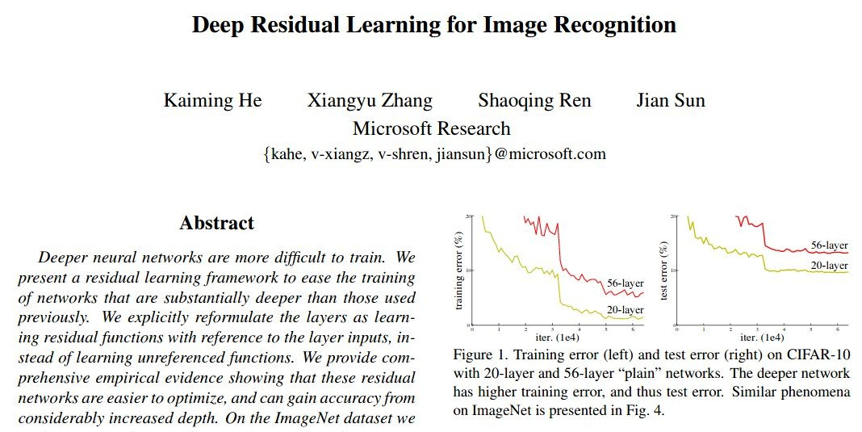
ResNet-34
Proposed in 2015

Slide 152
ResNet-34
Proposed in 2015
It has 34 layers with learnable parameters

Slide 153
ResNet-34
Proposed in 2015
It has 34 layers with learnable parameters
Architecture details:
16 residual blocks

Slide 154
ResNet-34
Proposed in 2015
It has 34 layers with learnable parameters
Architecture details:
16 residual blocks
Mostly 3 X 3 filters are used

Slide 155
ResNet-34
Proposed in 2015
It has 34 layers with learnable parameters
Architecture details:
16 residual blocks
Mostly 3 X 3 filters are used
Batch normalization layer is used after each convolution operation

Slide 156
ResNet-34
Proposed in 2015
It has 34 layers with learnable parameters
Architecture details:
16 residual blocks
Mostly 3 X 3 filters are used
Batch normalization layer is used after each convolution operation
Activation function: ReLU

Slide 157
ResNet-34
Proposed in 2015
It has 34 layers with learnable parameters
Architecture details:
16 residual blocks
Mostly 3 X 3 filters are used
Batch normalization layer is used after each convolution operation
Activation function: ReLU
Trained on imagenet dataset

Slide 158

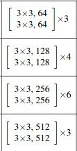
Architecture: ResNet-34
Input
Adaptive Average Pooling
Fully Connected Layer (1000)

Slide 159
Architecture: ResNet-34
Input
224, 224, 3

Slide 160
Architecture: ResNet-34
Input
224, 224, 3
112, 112, 64

Slide 161
Architecture: ResNet-34
Input
224, 224, 3
112, 112, 64
56, 56, 64

Slide 162

Architecture: ResNet-34
Input
224, 224, 3
112, 112, 64
56, 56, 64
56, 56, 64

Slide 163
Architecture: ResNet-34
Input (56, 56, 64)
224, 224, 3
Input
112, 112, 64
56, 56, 64
56, 56, 64

Slide 164
Architecture: ResNet-34
Input (56, 56, 64)
224, 224, 3
Input
112, 112, 64
56, 56, 64
Conv (3x3)
56, 56, 64
Batchnorm
+ ReLU
Conv (3x3)
Batchnorm

Slide 165
Architecture: ResNet-34
Input (56, 56, 64)
224, 224, 3
Input
112, 112, 64
56, 56, 64
Conv (3x3)
56, 56, 64
Batchnorm
+ ReLU
Conv (3x3)
x
Batchnorm
F(x) +

Slide 166
Architecture: ResNet-34
Input (56, 56, 64)
224, 224, 3
Input
112, 112, 64
56, 56, 64
Conv (3x3)
56, 56, 64
Batchnorm
+ ReLU
Conv (3x3)
x
Batchnorm
F(x) +
ReLU
Output (56, 56, 64)

Slide 167
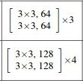
Architecture: ResNet-34
Input
224, 224, 3
112, 112, 64
56, 56, 64
56, 56, 64
28, 28, 128

Slide 168
Architecture: ResNet-34
Input (56, 56, 64)
224, 224, 3
Input
112, 112, 64
56, 56, 64
56, 56, 64
28, 28, 128

Slide 169
Architecture: ResNet-34
Input (56, 56, 64)
224, 224, 3
Input
112, 112, 64
56, 56, 64
Conv (3x3)
Stride = (2,2)
56, 56, 64
Batchnorm
+ ReLU
Conv (3x3)
28, 28, 128
Batchnorm

Slide 170
Architecture: ResNet-34
Input (56, 56, 64)
224, 224, 3
Input
112, 112, 64
56, 56, 64
Conv (3x3)
Stride = (2,2)
56, 56, 64
Batchnorm
+ ReLU
Conv (3x3)
28, 28, 128
Batchnorm
(28, 28, 128)

Slide 171
Architecture: ResNet-34
Input (56, 56, 64)
Input
224, 224, 3
112, 112, 64
56, 56, 64
Conv (3x3)
Stride = (2,2)
56, 56, 64
Batchnorm
+ ReLU
Conv (3x3)
28, 28, 128
Batchnorm
F(x) + x
(28, 28, 128)

Slide 172
Architecture: ResNet-34
Input (56, 56, 64)
224, 224, 3
Input
112, 112, 64
56, 56, 64
Conv (3x3)
Stride = (2,2)
56, 56, 64
Batchnorm
+ ReLU
Conv (3x3)
28, 28, 128
Batchnorm
F(x): (28, 28, 128)
F(x) + x
(28, 28, 128)
x: (56, 56, 64)

Slide 173
Architecture: ResNet-34
Input (56, 56, 64)
224, 224, 3
Input
112, 112, 64
56, 56, 64
Conv (3x3)
Stride = (2,2)
56, 56, 64
Batchnorm
+ ReLU
Conv (3x3)
28, 28, 128
Batchnorm
F(x): (28, 28, 128)
F(x) + W_{s}x
(28, 28, 128)
x: (56, 56, 64)

Slide 174
Architecture: ResNet-34
(56, 56, 64)
F(x) + W_{s}x

Slide 175
Architecture: ResNet-34
(56, 56, 64)
F(x) + W_{s}x
Conv (1X1) Stride = (2,2)

Slide 176
Architecture: ResNet-34
(56, 56, 64)
F(x) + W_{s}x
Conv (1X1) Stride = (2,2)
(28, 28, 128)

Slide 177
Architecture: ResNet-34
Input (56, 56, 64)
224, 224, 3
Input
112, 112, 64
56, 56, 64
Conv (3x3)
Stride = (2,2)
56, 56, 64
Batchnorm
+ ReLU
Conv (3x3)
W x
s
28, 28, 128
Batchnorm
F(x) +
ReLU
Output (28, 28, 128)

Slide 178
Architecture: ResNet-34
Input (56, 56, 64)
224, 224, 3
Input
112, 112, 64
56, 56, 64
Conv (3x3)
Stride = (2,2)
56, 56, 64
Batchnorm
+ ReLU
Conv (3x3)
W x
s
28, 28, 128
Batchnorm
F(x) +
ReLU
Output (28, 28, 128)

Slide 179
Architecture: ResNet-34
Input (28, 28, 128)
224, 224, 3
Input
112, 112, 64
56, 56, 64
Conv (3x3)
56, 56, 64
Batchnorm
+ ReLU
Conv (3x3)
x
28, 28, 128
Batchnorm
F(x) +
ReLU
Output (28, 28, 128)

Slide 180
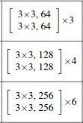
Architecture: ResNet-34
Input
224, 224, 3
112, 112, 64
56, 56, 64
56, 56, 64
28, 28, 128
14, 14, 256

Slide 181
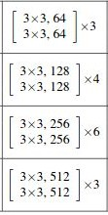
Architecture: ResNet-34
Input
224, 224, 3
112, 112, 64
56, 56, 64
56, 56, 64
28, 28, 128
14, 14, 256
7, 7, 512

Slide 182
Architecture: ResNet-34
Input
224, 224, 3
112, 112, 64
56, 56, 64
56, 56, 64
28, 28, 128
14, 14, 256
7, 7, 512
Adaptive Average Pooling
1, 1, 512

Slide 183
Architecture: ResNet-34
Input
224, 224, 3
112, 112, 64
56, 56, 64
56, 56, 64
28, 28, 128
14, 14, 256
7, 7, 512
Adaptive Average Pooling
1, 1, 512
Fully Connected Layer (1000)

Slide 184
Summary: ResNet-34

Slide 185
Summary: ResNet-34
It has 34 layers with learnable parameters

Slide 186
Summary: ResNet-34
It has 34 layers with learnable parameters
Takes RGB image as input

Slide 187
Summary: ResNet-34
It has 34 layers with learnable parameters
Takes RGB image as input
Architecture details:
16 residual blocks
Mostly 3 X 3 filters are used
Batch normalization layer is used after each convolution operation

Slide 188
Different versions of ResNet

Slide 189
Different versions of ResNet
Input (x)
Conv (3x3)
Batchnorm
+ ReLU
Conv (3x3)
Batchnorm
F(x) + x
ReLU
Output
Residual Block for ResNet-34

Slide 190
Different versions of ResNet
Input (x)
Input (x)
Conv (1x1)
Conv (3x3)
Batchnorm
+ ReLU
Batchnorm
+ ReLU
Conv (3x3)
Conv (3x3)
Batchnorm
+ ReLU
Batchnorm
Conv (1x1)
x |  | Batchnor
F(x) + x
m
ReLU
F(x) +
Output
ReLU
Conv (1x1)
Residual Block for ResNet-34

Slide 191
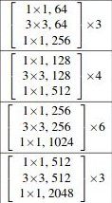
Architecture: ResNet-50
Input
Adaptive Average Pooling
Fully Connected Layer (1000)

Slide 192
Architecture: ResNet-50
Input
Input
ResNet-34
Adaptive Average Pooling
Adaptive Average Pooling
Fully Connected Layer (1000)
Fully Connected Layer (1000)

Slide 193
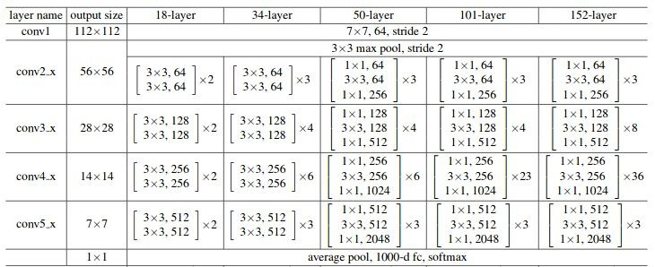
Different versions of ResNet

Slide 194
Comparing versions of ResNet

Slide 195
Comparing versions of ResNet
Model | Top-5 Error
ResNet-34 | 5.71%

Slide 196
Comparing versions of ResNet
Model | Top-5 Error
ResNet-34 | 5.71%
ResNet-50 | 5.25%

Slide 197
Comparing versions of ResNet
Model | Top-5 Error
ResNet-34 | 5.71%
ResNet-50 | 5.25%
ResNet-101 | 4.60%

Slide 198
Comparing versions of ResNet
Model | Top-5 Error
ResNet-34 | 5.71%
ResNet-50 | 5.25%
ResNet-101 | 4.60%
ResNet-151 | 4.49%

Slide 199
ResNet
Previous layer Output (x)
Weighted Layer
 | ReLU
Weighted Layer
) + x | ReLU
F(x
Next layer Input
Residual Block

Slide 200
ResNet
Previous layer Output (x)
Weighted Layer
 | ReLU
Gradient Flow
Weighted Layer
F(x) + x
ReLU
Next layer Input
Residual Block

Slide 201
DenseNet

Slide 202
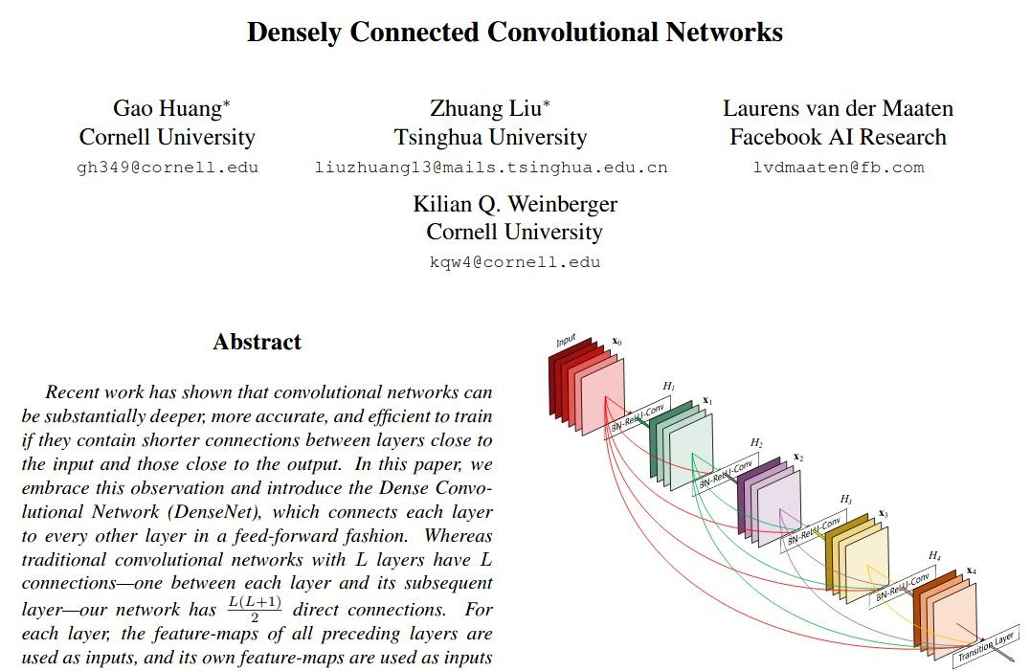
DenseNet
Proposed in 2018

Slide 203
DenseNet
Proposed in 2018
Architectural details:
Mosty 3 X 3 convolutions are used

Slide 204
DenseNet
Proposed in 2018
Architectural details:
Mosty 3 X 3 convolutions are used
Batch normalization and ReLU used before conv layers in dense blocks

Slide 205
DenseNet
Proposed in 2018
Architectural details:
Mosty 3 X 3 convolutions are used
Batch normalization and ReLU used before conv layers in dense blocks
1 X 1 convolution used to reduce the size of feature map

Slide 206
DenseNet
Proposed in 2018
Architectural details:
Mosty 3 X 3 convolutions are used
Batch normalization and ReLU used before conv layers in dense blocks
1 X 1 convolution used to reduce the size of feature map
Connects each layer to all the subsequent layer

Slide 207
DenseNet
Proposed in 2018
Architectural details:
Mosty 3 X 3 convolutions are used
Batch normalization and ReLU used before conv layers in dense blocks
1 X 1 convolution used to reduce the size of feature map
Connects each layer to all the subsequent layer
Do not add features using element-wise addition, instead it concatenates the features

Slide 208
Architecture: DenseNet

Slide 209
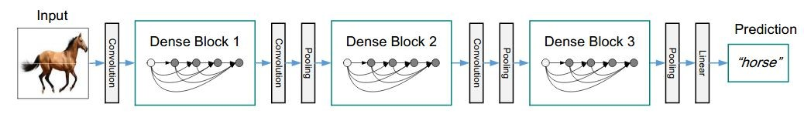
Architecture: DenseNet

Slide 210
Architecture: DenseNet

Slide 211
Architecture: DenseNet

Slide 212
Architecture: DenseNet

Slide 213
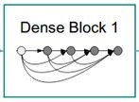
Understanding Dense Blocks

Slide 214
Understanding Dense Blocks
Input (56, 56, 64)

Slide 215
Understanding Dense Blocks
Input (56, 56, 64)
Block 1

Slide 216
Understanding Dense Blocks
Input (56, 56, 64)
Block 1

Slide 217
Understanding Dense Blocks
Input (56, 56, 64)
Block 1
BN - ReLU -
Conv(1X1)

Slide 218
Understanding Dense Blocks
Input (56, 56, 64)
Block 1
BN - ReLU -
Conv(1X1)
(56, 56, 128)

Slide 219
Understanding Dense Blocks
Input (56, 56, 64)
Block 1
BN - ReLU -
Conv(1X1)
BN - ReLU -
Conv(3X3)
(56, 56, 128)

Slide 220
Understanding Dense Blocks
Input (56, 56, 64)
Block 1
Padding = 1
BN - ReLU -
Conv(1X1)
BN - ReLU -
Conv(3X3)
(56, 56, 128)

Slide 221
Understanding Dense Blocks
Input (56, 56, 64)
Block 1
Padding = 1
BN - ReLU -
Conv(1X1)
BN - ReLU -
Conv(3X3)
(56, 56, 128)
(56, 56, 32)

Slide 222
Understanding Dense Blocks
Input (56, 56, 64)
Block 1
(56, 56, 32)

Slide 223
Understanding Dense Blocks
Input (56, 56, 64)
Block 1
(56, 56, 32)
Block 2

Slide 224
Understanding Dense Blocks
Input (56, 56, 64)
Block 1
(56, 56, 32)
Block 2

Slide 225
Understanding Dense Blocks
Input Shape: (56, 56, 96)
Input (56, 56, 64)
Block 1
(56, 56, 32)
Block 2

Slide 226
Understanding Dense Blocks
Input Shape: (56, 56, 96)
Input (56, 56, 64)
Block 1
(56, 56, 32)
Block 2

Slide 227
Understanding Dense Blocks
 |  |  |  | Input Shape: (56, 56, 96)
Input |  | Block 1 |  | Block 2
(56, 56, 64) |  | (56, 56, 32)
 |  |  |  | BN - ReLU - Conv(1X1)
 |  |  |  | (56, 56, 128)

Slide 228
Understanding Dense Blocks
Input Shape: (56, 56, 96)
Input (56, 56, 64)
Block 1
(56, 56, 32)
Block 2
Padding = 1
BN - ReLU -
Conv(1X1)
BN - ReLU -
Conv(3X3)
(56, 56, 128)
(56, 56, 32)

Slide 229
Understanding Dense Blocks
Input (56, 56, 64)
Block 1
(56, 56, 32)
Block 2
(56, 56, 32)

Slide 230
Understanding Dense Blocks
Input (56, 56, 64)
Block 1
(56, 56, 32)
Block 2
(56, 56, 32)
Block 3

Slide 231
Understanding Dense Blocks
Input (56, 56, 64)
Block 1
(56, 56, 32)
Block 2
(56, 56, 32)
Block 3

Slide 232
Understanding Dense Blocks
Input (56, 56, 64)
Block 1
(56, 56, 32)
Block 2
(56, 56, 32)
Block 3

Slide 233
Understanding Dense Blocks
Input Shape: (56, 56, 128)
Input (56, 56, 64)
Block 1
(56, 56, 32)
Block 2
(56, 56, 32)
Block 3

Slide 234
Understanding Dense Blocks
Input (56, 56, 64)
Block 1
(56, 56, 32)
Block 2
(56, 56, 32)
Block 3
(56, 56, 32)

Slide 235
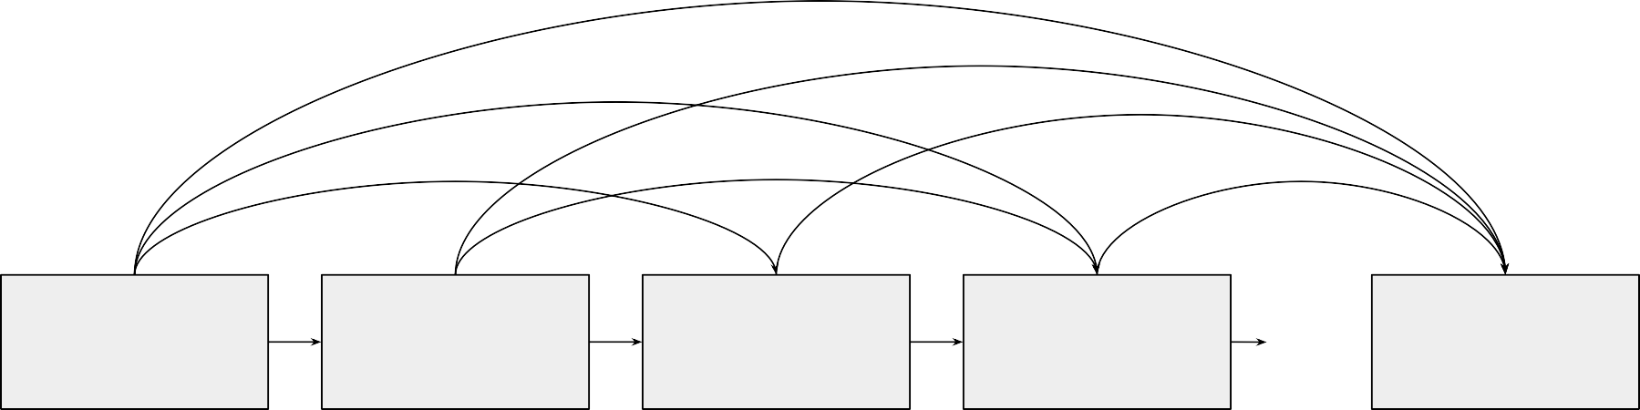
Understanding Dense Blocks
Input (56, 56, 64)
Block 1
(56, 56, 32)
Block 2
(56, 56, 32)
Block 3
(56, 56, 32)
Block 6
(56, 56, 32)

Slide 236
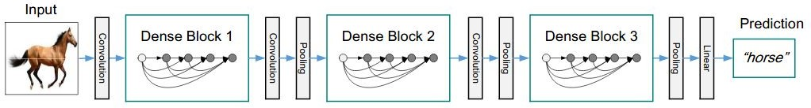
Architecture: DenseNet
Input (56, 56, 64)
Block 1
(56, 56, 32)
Block 2
(56, 56, 32)
Block 3
(56, 56, 32)
Block 6
(56, 56, 32)

Slide 237
Architecture: DenseNet
Input (56, 56, 64)
Block 1
(56, 56, 32)
Block 2
(56, 56, 32)
Block 3
(56, 56, 32)
Block 6
(56, 56, 32)
Output shape: (56, 56, 64 + 6*32)

Slide 238
Architecture: DenseNet
Input (56, 56, 64)
Block 1
(56, 56, 32)
Block 2
(56, 56, 32)
Block 3
(56, 56, 32)
Block 6
(56, 56, 32)
Output shape: (56, 56, 64 + 6*32) = (56, 56, 256)

Slide 239
Architecture: DenseNet
(56, 56, 256)

Slide 240
Architecture: DenseNet
(56, 56, 256)

Slide 241
Architecture: DenseNet
(56, 56, 256)
Transition Layers

Slide 242
Architecture: DenseNet
(56, 56, 256)
Transition Layers
Input (56, 56, 256)

Slide 243
Architecture: DenseNet
(56, 56, 256)
Transition Layers
Input (56, 56, 256)
BN - ReLU - Conv(1X1)

Slide 244
Architecture: DenseNet
(56, 56, 256)
Transition Layers
Input (56, 56, 256)
BN - ReLU - Conv(1X1)
(56, 56, 128)

Slide 245
Architecture: DenseNet
(56, 56, 256)
Transition Layers
Input (56, 56, 256)
BN - ReLU - Conv(1X1)
Average Pooling (2X2, stride = 2)
(56, 56, 128)

Slide 246
Architecture: DenseNet
(56, 56, 256)
Transition Layers
Input (56, 56, 256)
BN - ReLU - Conv(1X1)
Average Pooling (2X2, stride = 2)
(56, 56, 128)
(28, 28, 128)

Slide 247
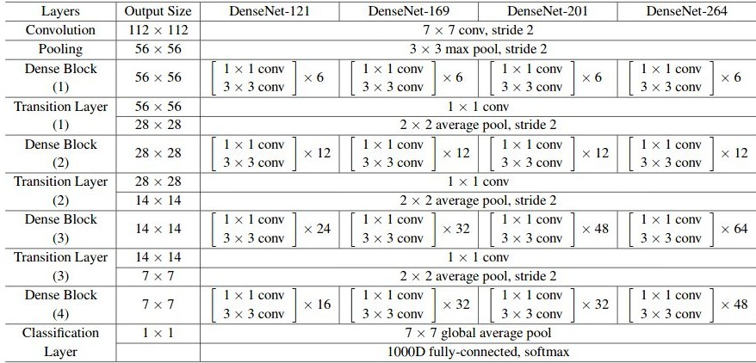
Architecture: DenseNet

Slide 248
Architecture: DenseNet

Slide 249
Advantages of Dense Blocks

Slide 250
Advantages of Dense Blocks
Resolves the issue of vanishing gradients
Input (56, 56, 64)
Block 1
(56, 56, 32)
Block 2
(56, 56, 32)
Block 3
(56, 56, 32)
Block 6
(56, 56, 32)

Slide 251
Advantages of Dense Blocks
Resolves the issue of vanishing gradients
Encourages feature reuse
Input (56, 56, 64)
Block 1
(56, 56, 32)
Block 2
(56, 56, 32)
Block 3
(56, 56, 32)
Block 6
(56, 56, 32)

Slide 252
Advantages of Dense Blocks
Resolves the issue of vanishing gradients
Encourages feature reuse
Reduces number of parameters

Slide 253
Comparing versions of DenseNet

Slide 254
Comparing versions of DenseNet
Model | Top-5 Error
DenseNet-121 | 7.71%

Slide 255
Comparing versions of DenseNet
Model | Top-5 Error
DenseNet-121 | 7.71%
DenseNet-169 | 6.85%

Slide 256
Comparing versions of DenseNet
Model | Top-5 Error
DenseNet-121 | 7.71%
DenseNet-169 | 6.85%
DenseNet-201 | 6.34%

Slide 257
Comparing versions of DenseNet
Model | Top-5 Error
DenseNet-121 | 7.71%
DenseNet-169 | 6.85%
DenseNet-201 | 6.34%
DenseNet-264 | 6.12%

Slide 258
Thank You

